Slide 1
Capstone project-the battle of neighborhoods
Exploring Zomato dataset to cluster restaurants in New Delhi, India

Slide 2
Introduction
New Delhi is the national capital of India. It has a population of 257,803 and is the largest commercial city in Northern India. New Delhi is a cosmopolitan city due to the multi-ethnic and multi-cultural presence of the vast Indian bureaucracy and political system. The city's capital status has amplified the importance of national events and holidays. The city is already among the world's fastest changing cities, with an ability to embrace technological change, and deal with rapid population growth while strengthening global connectivity. Traditionally speaking, a mixture of ancient Indian and Mughal styled cuisine is now considered as authentic Delhi cuisine. Street foods make a major part of the cuisine of the land. Top street food of Delhi is lassi, kebab, chole bhature, jalebis, falooda, samosa, butter chicken, Nihari, kulfi, and others.

Slide 3
objective
Which places have the best restaurant in New Delhi ?
Which all areas have the highest and lowest number of restaurants ?
Highest and lowest rated restaurants in New Delhi.
Display top 10 most common venue in New Delhi.
Clustering the restaurants in New Delhi based on common features.

Slide 4
Data
Data Source : Zomato dataset from Kaggle.
For this project, we need the following data :
List of New Delhi restaurants
Locality
Longitude
Ratings
Description : The dataset contains the required information and we will use this dataset to explore various restaurants located in various parts of New Delhi.

Slide 5
approach
Collect the Zomato Kaggle dataset for India
Extracting data for New Delhi.
Using FourSquare API, we will find all venues/restaurants for each locality.
Filter out the restaurants that are nearby locality.
Use Aggregate Rating for restaurant to find the best and worst place to eat.
Visualize the Ranking of localities using folium library in Python.

Slide 6
Steps taken
Imported libraries.
Imported Zomato dataset from Kaggle: https://raw.githubusercontent.com/haanjiankur/Capstone-Project---The-Battle-of-Neighborhoods/master/zomato.csv
Cleaned data and visualized restaurants in New Delhi using a map.
Visualized highest and lowest rated restaurants and localities.
Explored and analyzed neighborhoods of New Delhi.

Slide 7
Visualizations
Map of Delhi showing different clusters of restaurants.
Highest rated restaurants in top 10 localities of New Delhi.
Lowest rated restaurants in top10 localities of New Delhi.
Highest number of restaurants available in different localities of New Delhi.
Highest number of restaurants available in different localities of New Delhi.
5 clusters clustering various restaurants of New Delhi.

Slide 8
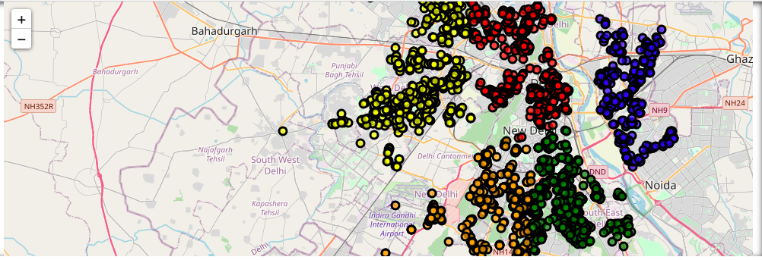
1.

Slide 9
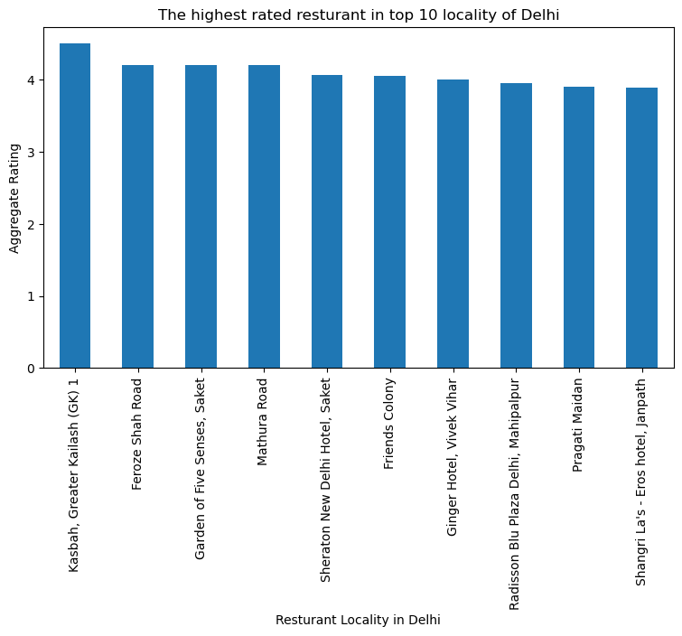
2.

Slide 10
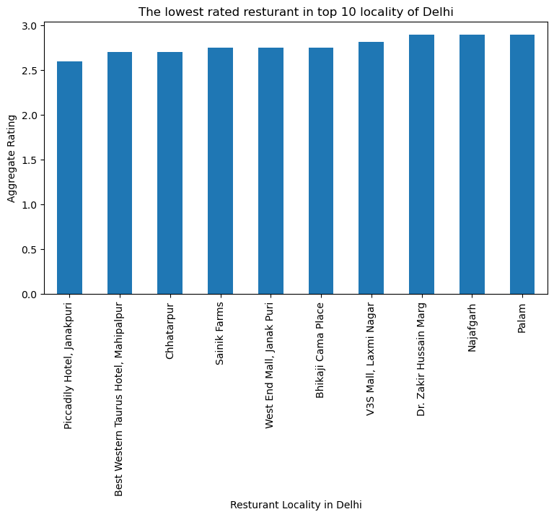
3.

Slide 11
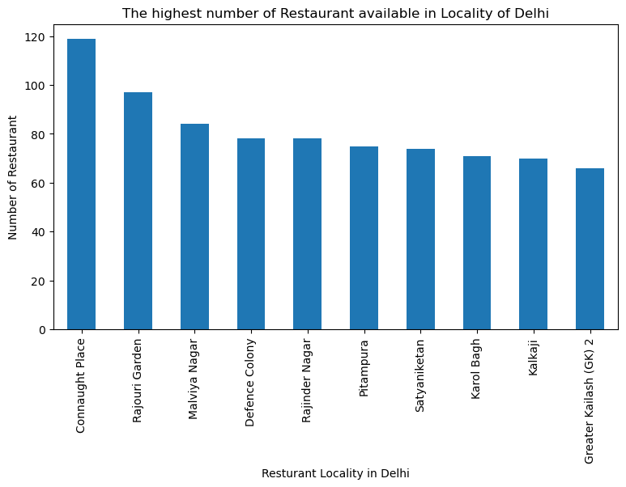
4.

Slide 12
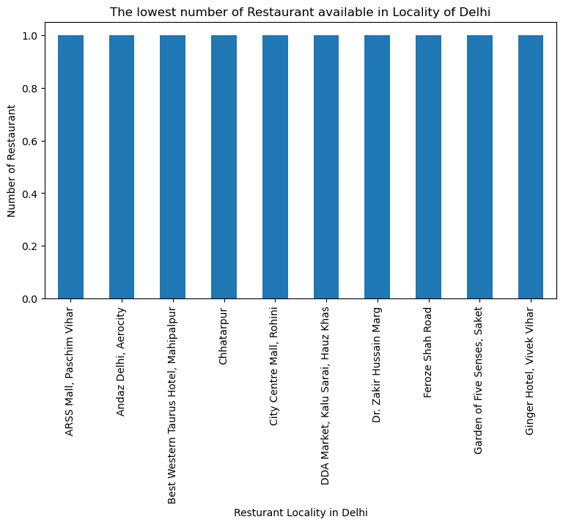
5.

Slide 13
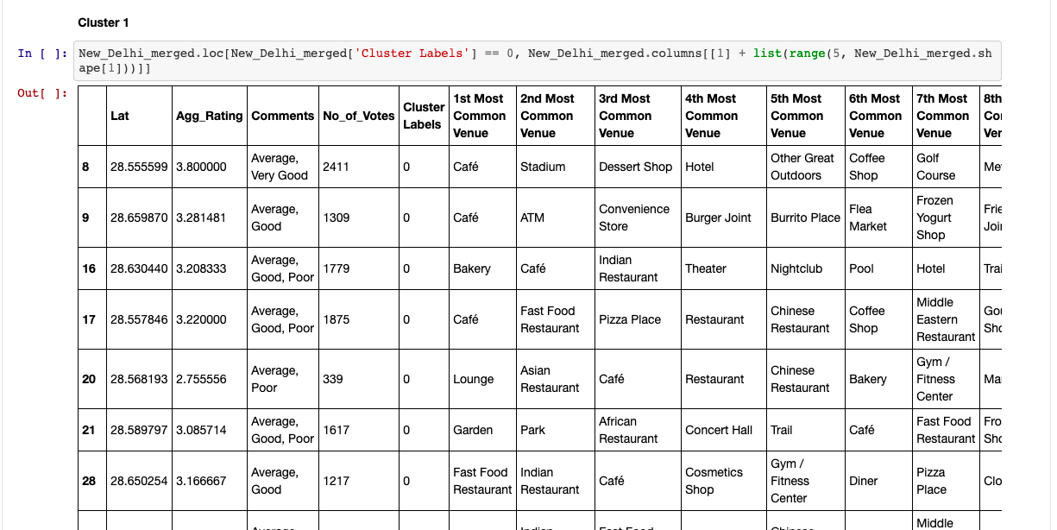
CLUSTER I: The Indian restaurants are most recommended venues nearby the locations.
Cluster I

Slide 14
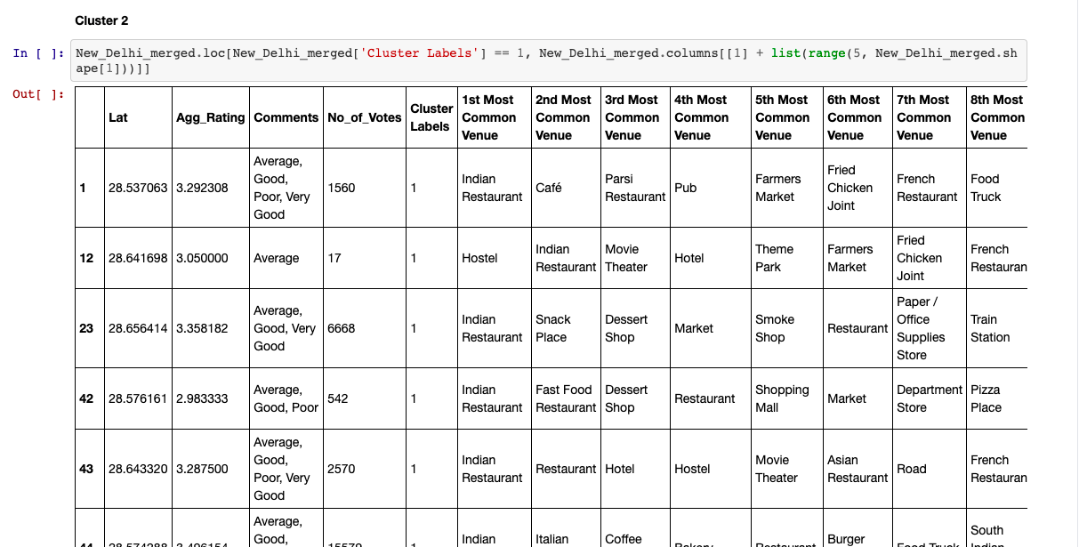
CLUSTER II: It is recommended for the Hotel and Nightclubs venues areas.

Slide 15
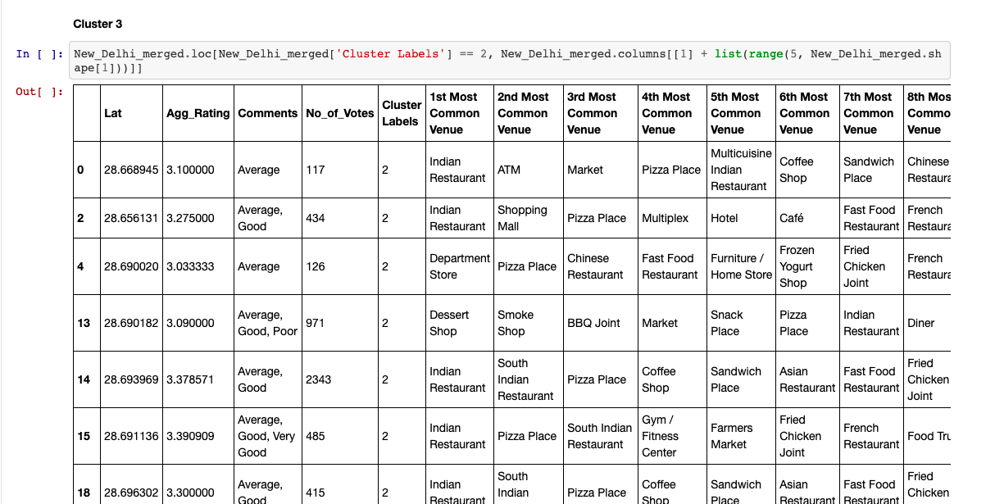
CLUSTER III: Pizza Place are most recommended venues Here.

Slide 16
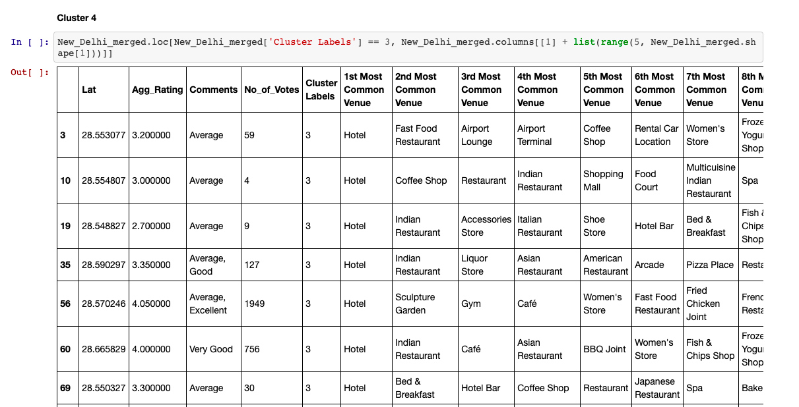
CLUSTER IV: Recommended for Cafe.

Slide 17
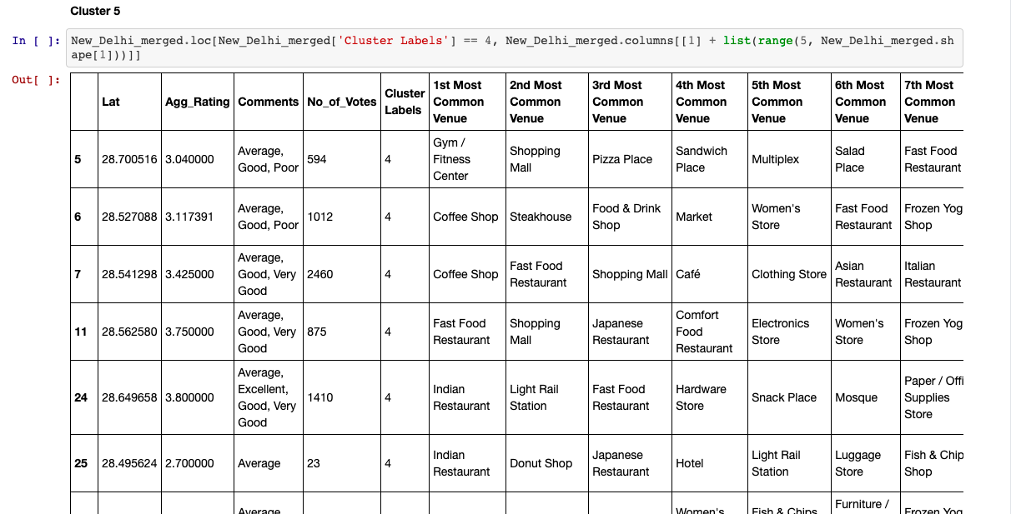
CLUSTER V: recommended for fast food restaurants.

Slide 18
Conclusion
Chanakyapuri, Pitampura, Safdarjung are some of the best neighborhoods for Chinese cuisine.
Panchsheel Park, Nehru Place have the best Chinese Restaurant.
Connaught Place, Rajouri Garden, Malviya Nagar are the best places for edible person.
Greater Kailash, Feroze Shah Soad, Saket have best rated restaurants in New Delhi.

